Slide 1
Deploying Machine Learning APIs with Python
Chase DeHan, PhD
Data Scientist – Progressive Leasing
github.com/chasedehan/big_mountain_2018
chasedehan@yahoo.com
Big Mountain Data and Dev Conference
Salt Lake City, UT
October 12, 2018

Slide 2

Machine Learning Models
How do I get this in prod?
No Idea
*Modified by me without permission
github.com/chasedehan/big_mountain_2018

Slide 3
Outline
Why use a REST API?
Basics of building a model with sklearn
We will build a model using the canonical Titanic dataset
Basics of the Flask framework
Put that ML model in a Flask application
Call that model from another application
github.com/chasedehan/big_mountain_2018

Slide 4
Why a REST API?
Unbundles machine learning from rest of tech stack
Allows to develop model and deploy in the same language
Doesn’t restrict model selection
github.com/chasedehan/big_mountain_2018

Slide 5
POST vs GET
Both Transfer data from client to server over HTTP
GET:
- Contains request parameter in URL string
POST:
- Carries request parameters in body (typically JSON or XML)
github.com/chasedehan/big_mountain_2018

Slide 6
Process
Build and evaluate model performance
Save the model
Build Flask Application
Load model
Handle requests and return score
Call API from another service/application
github.com/chasedehan/big_mountain_2018

Slide 7
Basics of Building ML Model
Prep Data
Cross Validate Predictions
Train Models
Evaluate Models
github.com/chasedehan/big_mountain_2018

Slide 8
Elements of Flask API
Loads model into memory
URL for request
Transforms data
Run data through model
Returns result
github.com/chasedehan/big_mountain_2018

Slide 9
Calling the Model API
Get URL of service
Package data in JSON or XML
Make request to service
Using any programming
Do something with the response
github.com/chasedehan/big_mountain_2018

Slide 10
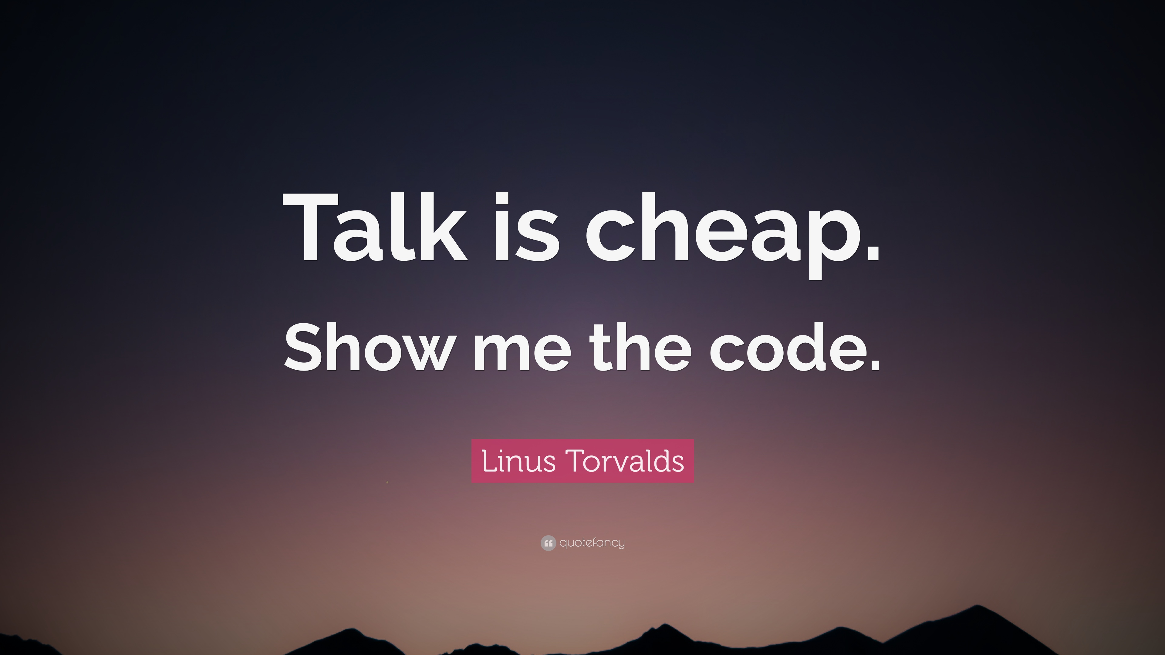
Go to Demo

Slide 11
Infrastructure / DevOps Considerations
Flask ships with a development server, but REALLY need to put it behind a real web server:
Apache, NGINX, Gunicorn, etc
http://flask.pocoo.org/docs/1.0/deploying/
Can deploy to AWS/GCP/Azure quite easily
https://cloud.google.com/appengine/docs/standard/python/getting-started/python-standard-env
Containers work well:
https://blog.miguelgrinberg.com/post/the-flask-mega-tutorial-part-xix-deployment-on-docker-containers
Make sure you set up logs the correct way:
http://flask.pocoo.org/docs/1.0/logging/
github.com/chasedehan/big_mountain_2018

Slide 12
Take Note Before Deploying
This talk was only about deploying machine learning models, not about how to build a good model.
Need to be diligent about virtual environments because the joblib/pkl files can break with different versions of sklearn
Code was built in a simplistic way for pedagogical purposes. For actual production, use appropriate software engineering practices.
github.com/chasedehan/big_mountain_2018

Slide 13
Questions?
Chase DeHan, PhD
Data Scientist – Progressive Leasing
github.com/chasedehan/big_mountain_2018
chasedehan@yahoo.com

